Slide 1

Industrial robots in harsh conditions Final Progress Review
Kin Tung
Eren Pekgöz
Daniel Pedraglio O'Hara

Slide 2
Quick recap on requirements
Main Goal:
Design a robot to assemble rock bolts (Rebar + Steel Plate)
Environmental Conditions
Operating Environment: Indoor and outdoor.
Temperature Range: –40 to +40 °C.
Lighting Conditions: All lighting conditions, including direct sunlight and complete darkness.
Environmental factors: Dust, mud, moisture, snow and rain.
Specification of materials
Steel Plate:
Dimension: 200x200x8 mm
Weight: 2.51kg
Rebar:
Dimension: 25mm Dia x 3000mm long
Weight: 11.56kg
Steel Weight Calculator, Steel Express
https://www.steelexpress.co.uk/steel-weight-calculator.html

Slide 3
Current Project Status
Design Completed
Prototyping Completed
Outstanding Tasks:
Poster
Final Report
Narration in video

Slide 4
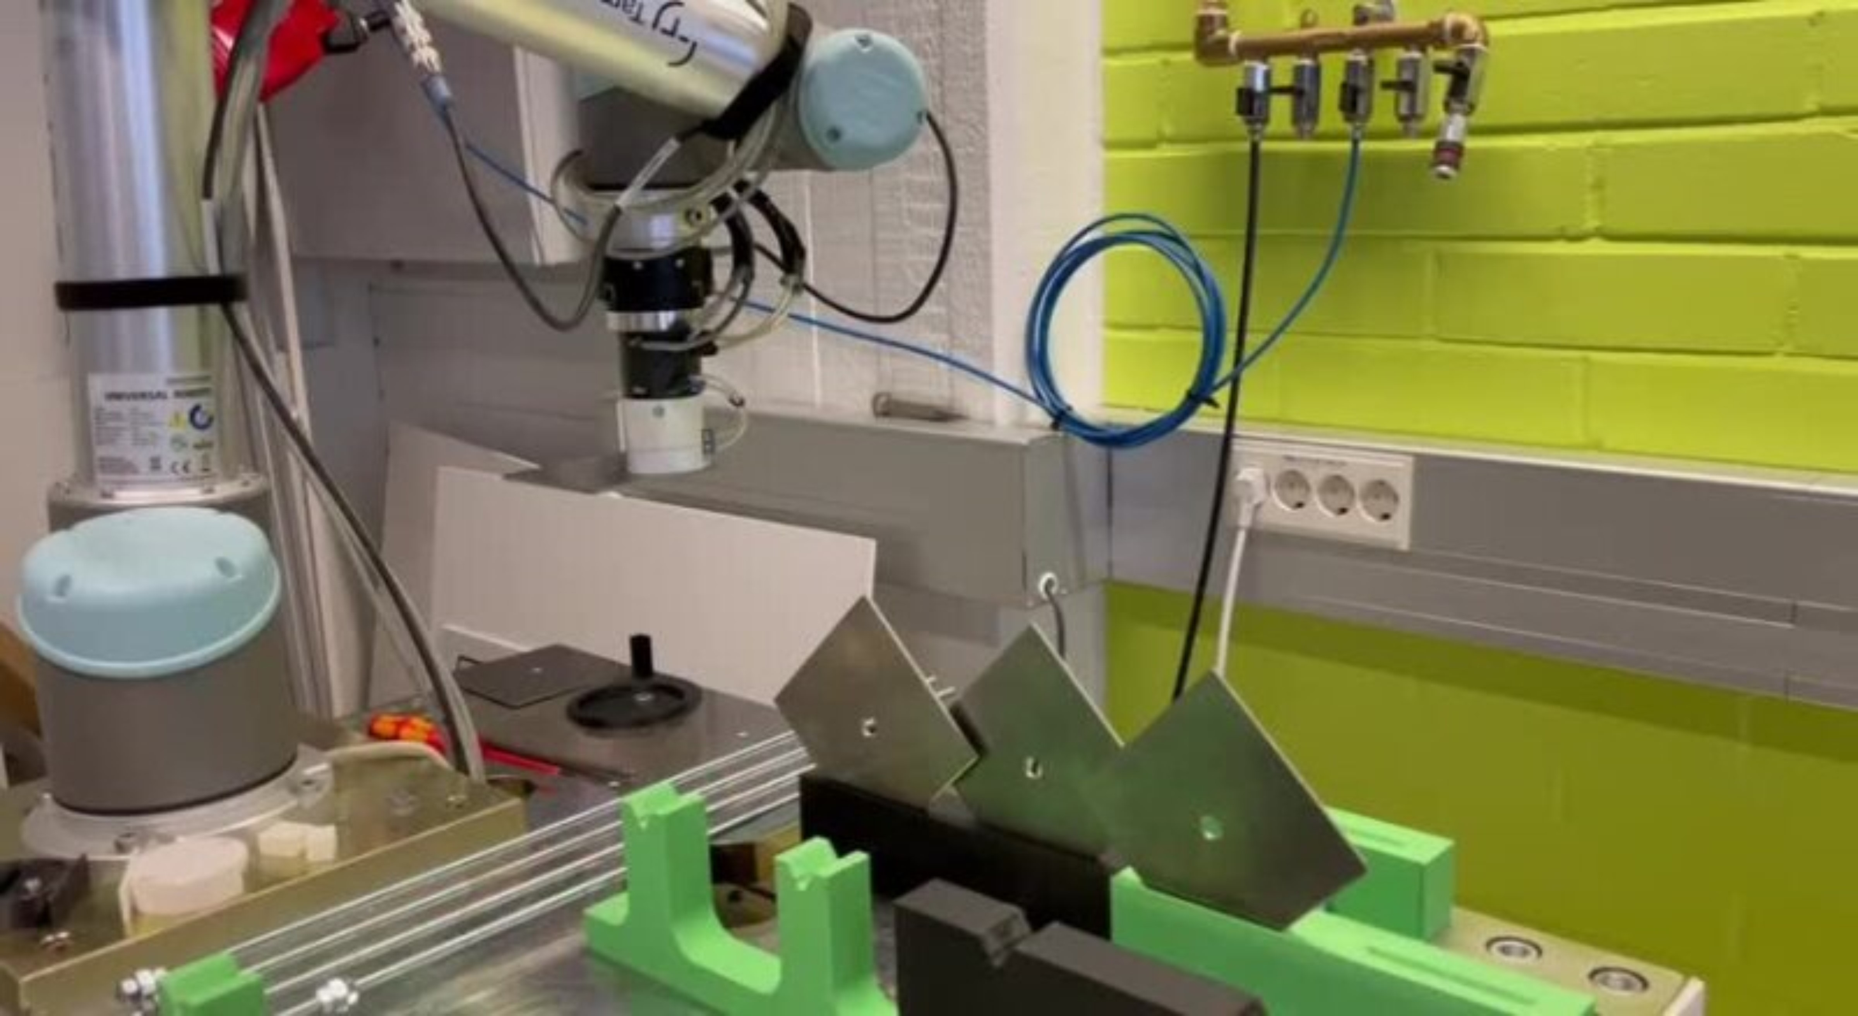
Video

Slide 5
Q&A

Slide 6
Thank you!

